Slide 1
VLSI Design Lab
Session No. 01
Dr. Vijay Rao Kumbhare
Assistant Professor (ECE)
K L University, Hyderabad
24/12/2022

Slide 2
Course Content: VLSI Design LAB (21EC2211A)
L-T-P-S | 3-1-4-0 | Credit | 5
Pre-requisites | NIL | Contact Hours | 6
Syllabus
1 Design and analysis of CMOS Inverter
2 Design and verify Logic gates using CMOS Logic
3 Implementation of Boolean expressions using CMOS Logic
4 Design and verify 1-bit comparator
5 Design of 2:1 MUX using Pass Transistor and Transmission Gate Logic
6 Design and verify half adder
7 Implementation of SR-Flip Flop using CMOS Logic
8 Design and verify Decoder
9 Physical Design and Verification of SRAM cell
10 Schematic and Physical Design of Ring Oscillator

Slide 3
Topic
Session Outcome 1: Design and analysis of CMOS Inverter

Slide 4
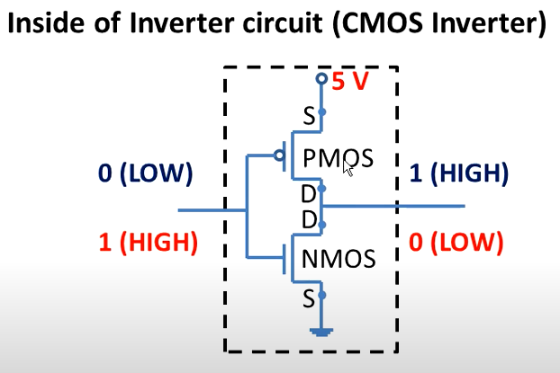
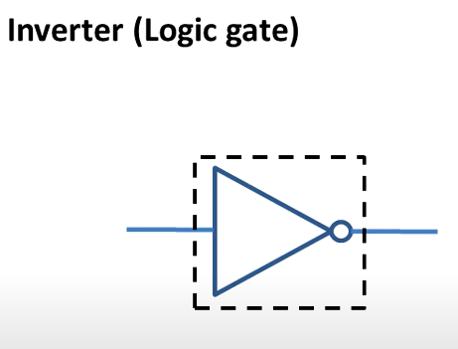


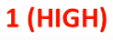
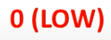
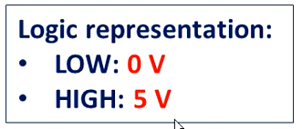
CMOS Inverter

Slide 5
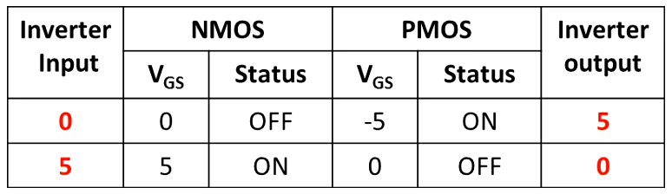
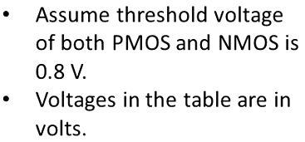
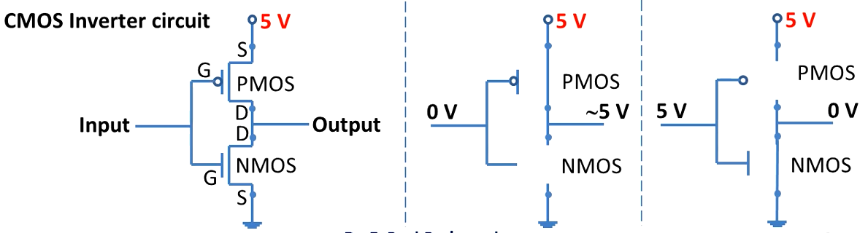
CMOS Inverter Operation

Slide 6
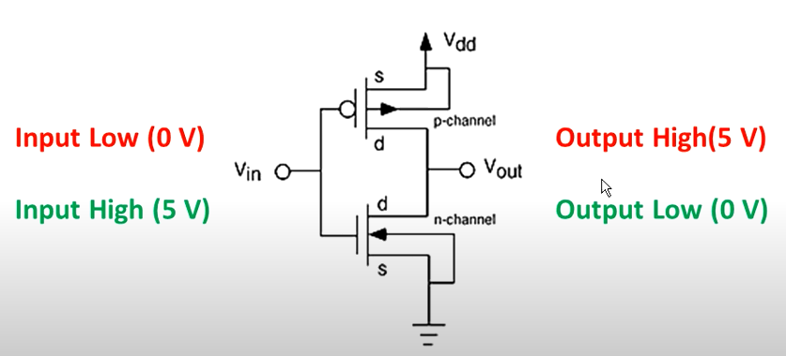
CMOS Inverter

Slide 7
Introduction to LTSpice

Slide 8
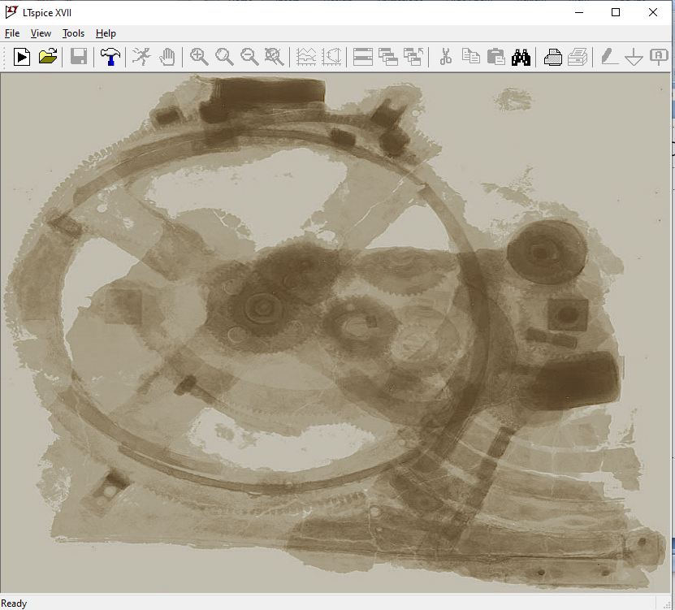
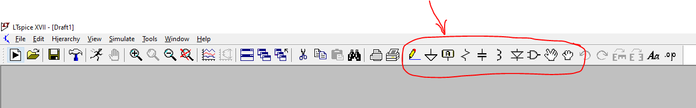
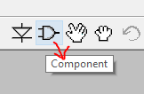
New Schematic

Slide 9
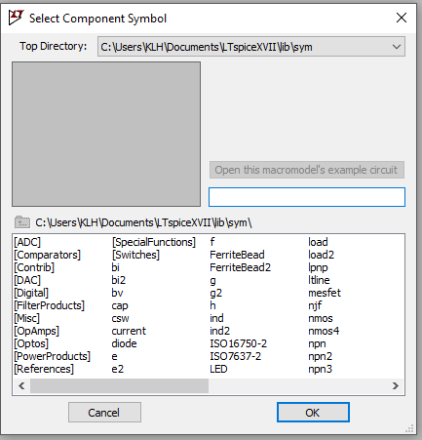
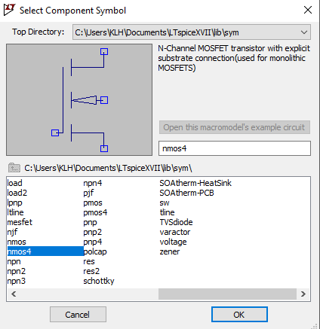
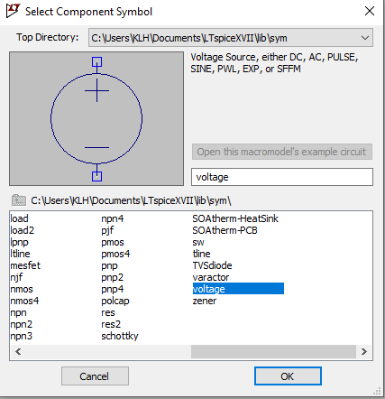

Slide 10
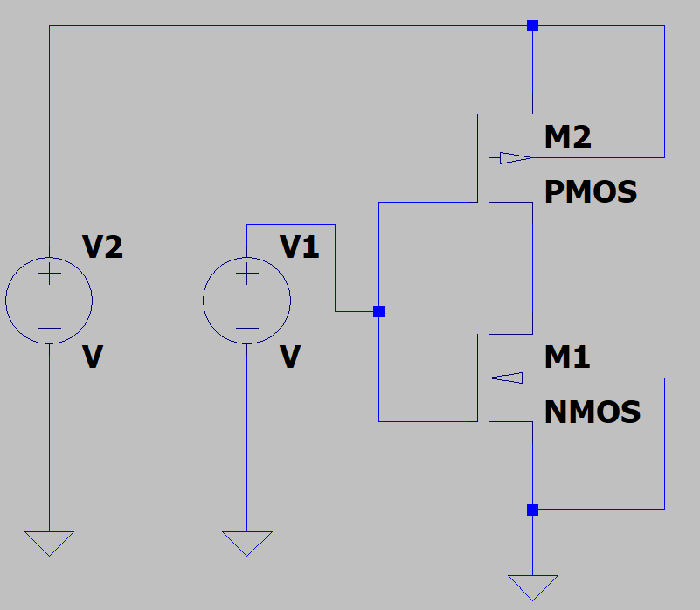
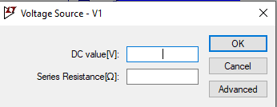
Once you right click on Voltage Source

Slide 11
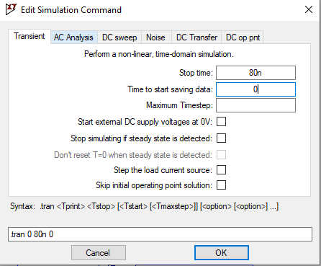
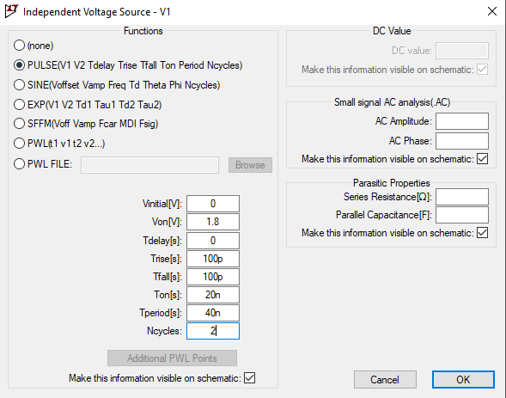
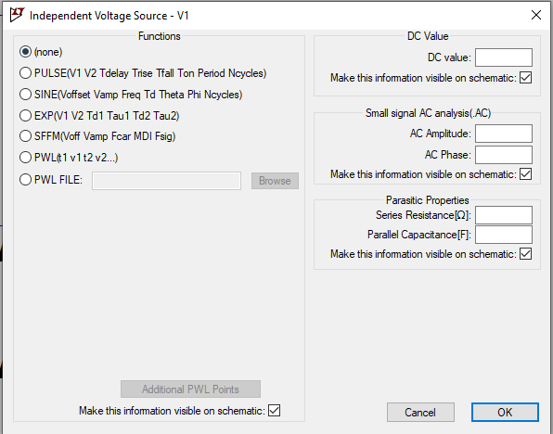
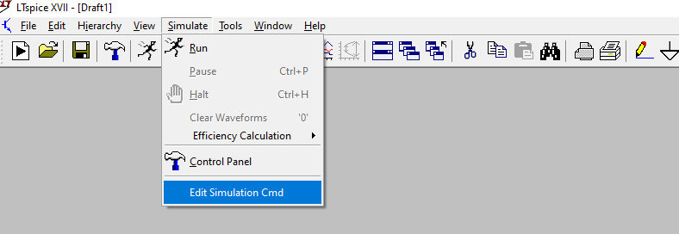

Slide 12
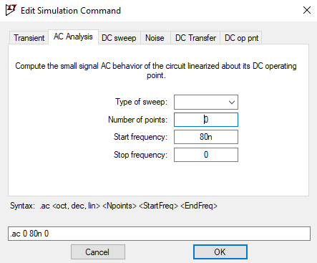
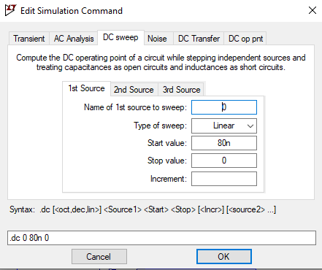
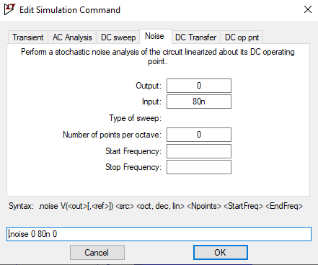
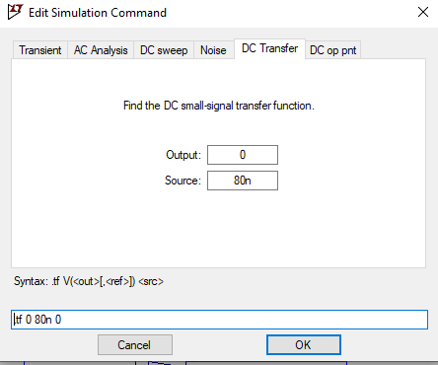
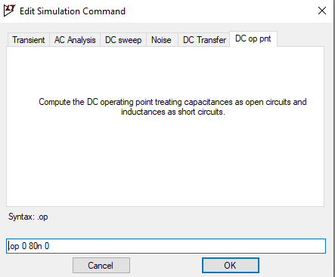

Slide 13
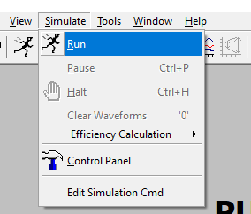
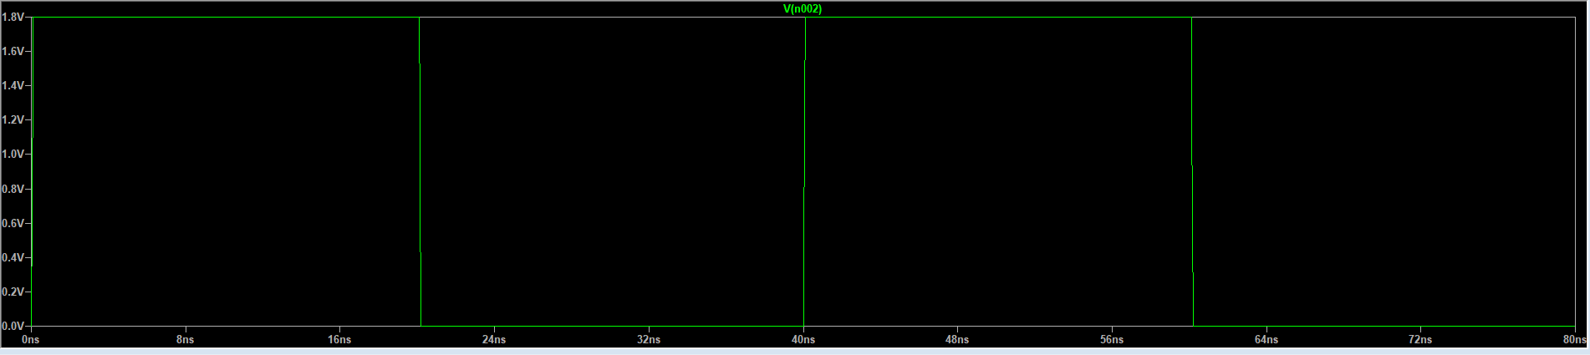
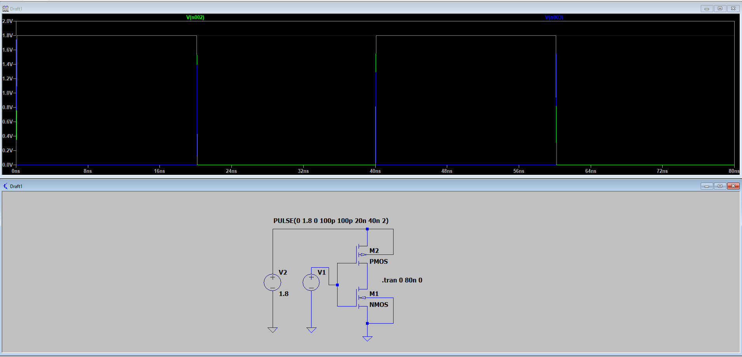
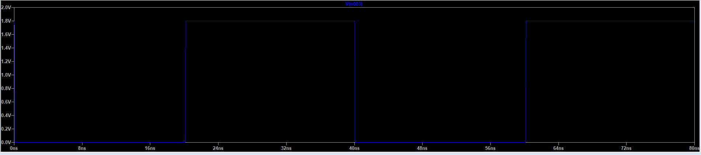

Slide 14
How to use Technology library file using LTSpice
LT spice working with tsmc018.lib in 5 steps
Copy the file tsmc018.lib to the directory Installationpath\LTC\SwCADIII\lib\sub
(Usually it is C: \Program Files\LTC\SwCADIII\lib\sub) and
the files cmosn.asy and cmosp.asy to the directory Installationpath\LTC\SwCADIII\lib\sym
(C: \Program Files\LTC\SwCADIII\lib\sym).
2) Load LT Spice : File-> New schematic
https://sanjayvidhyadharan.in/Downloads

Slide 15

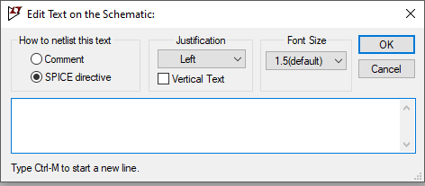
3) Click on .op as shown in Figure
Click here to mount the technology library
4) Type : .INCLUDE tsmc018.lib

Slide 16
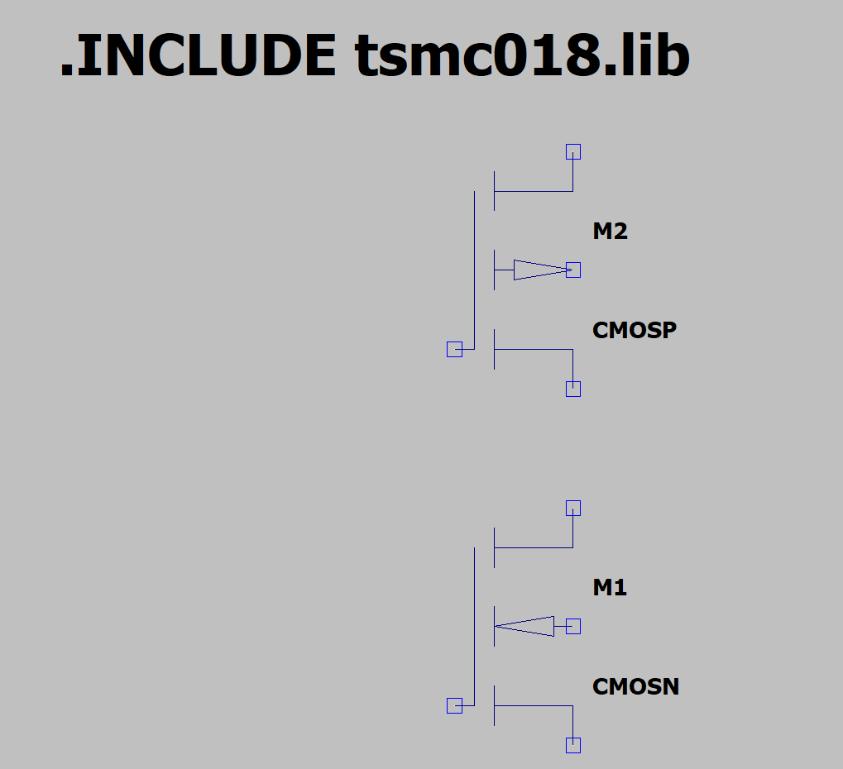
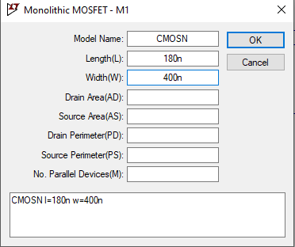
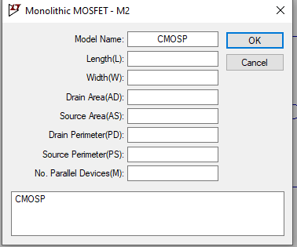
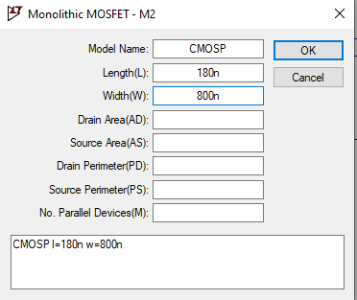

Slide 17
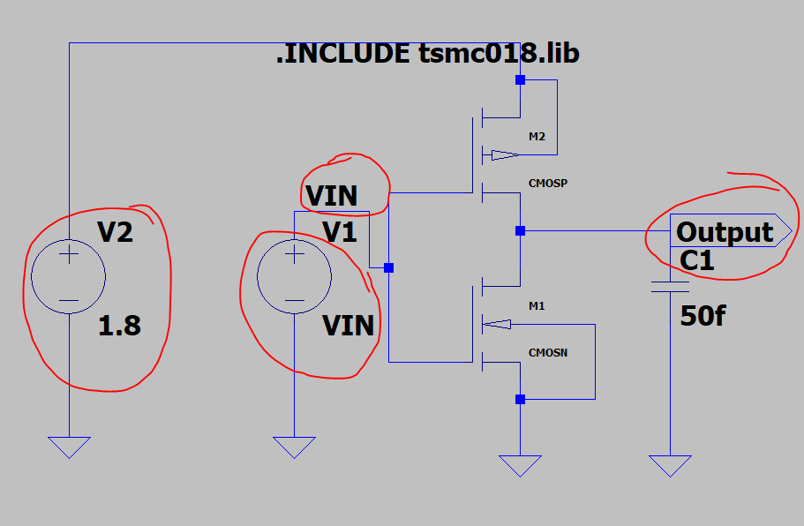
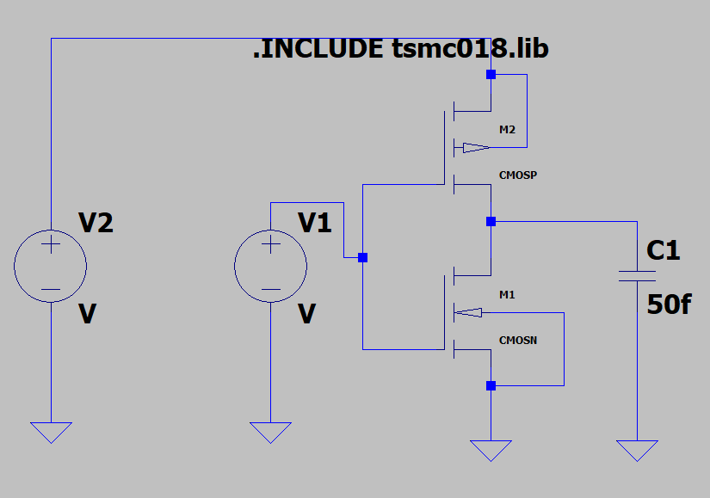
Go to EDIT SIMULATION PROFILE

Slide 18
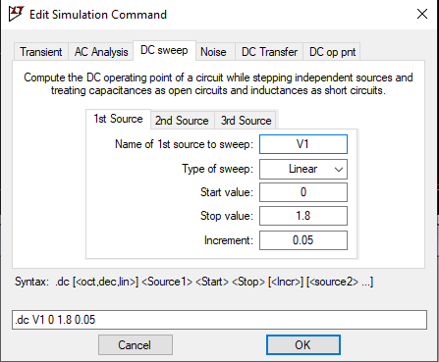
Run the simulator to observe the output

Slide 19
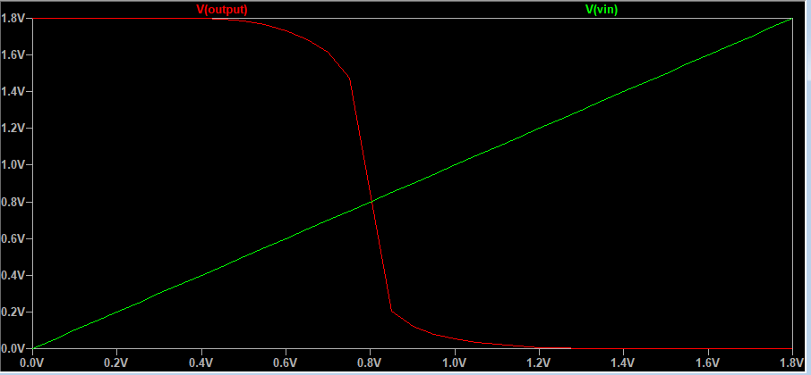

Slide 20
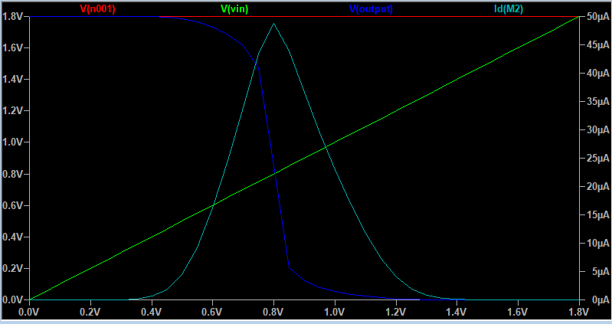

Slide 21
Introduction to Cadence Virtuoso

Slide 22
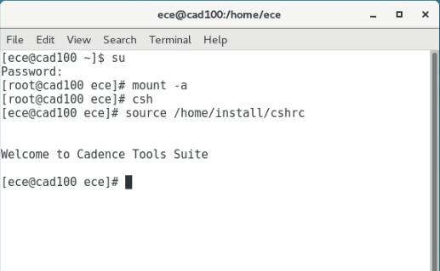
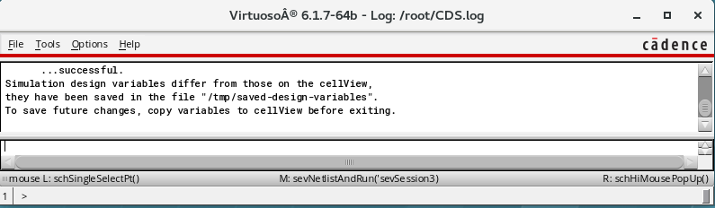
How to start Cadence Virtuoso
Open Terminal
Use the following Command into terminal
mount -a
csh
source /home/install/cshrc
Virtuoso &

Slide 23
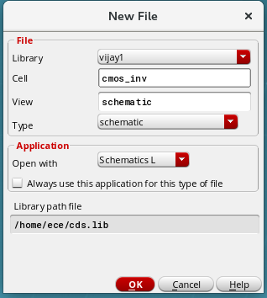
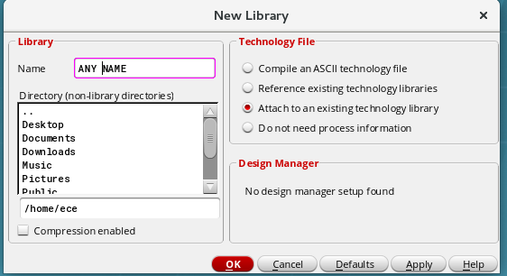

Steps to start
Again go to File→New→ Cellview

Slide 24
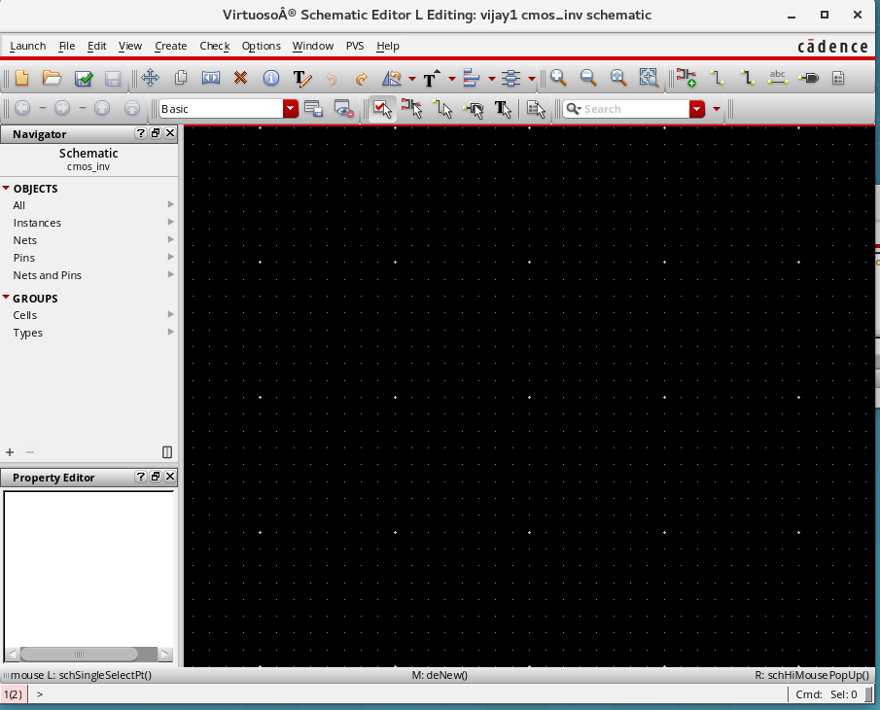

Slide 25
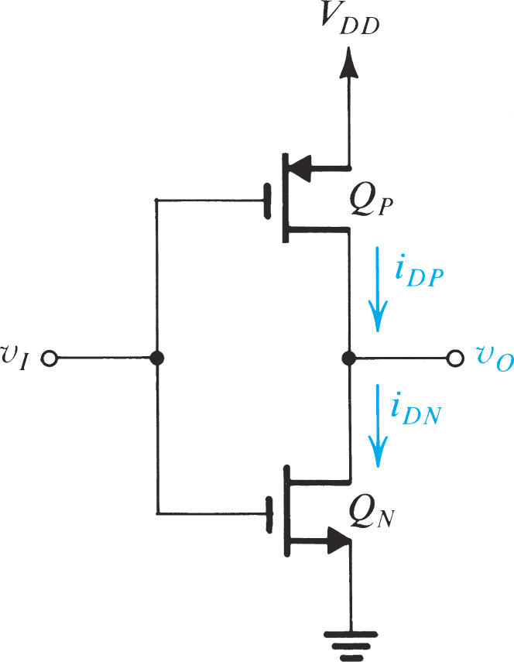
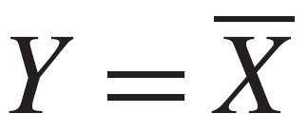
Task-1 CMOS Inverter
Figure 1

Slide 26
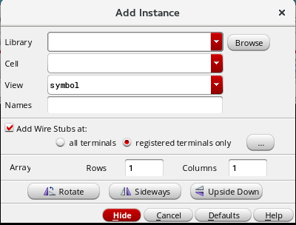
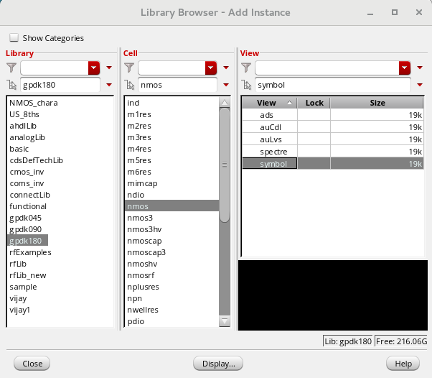
Some basic things to know
To access components→ Create → instance or Press I
Use Library based on technology requirement →

Slide 27
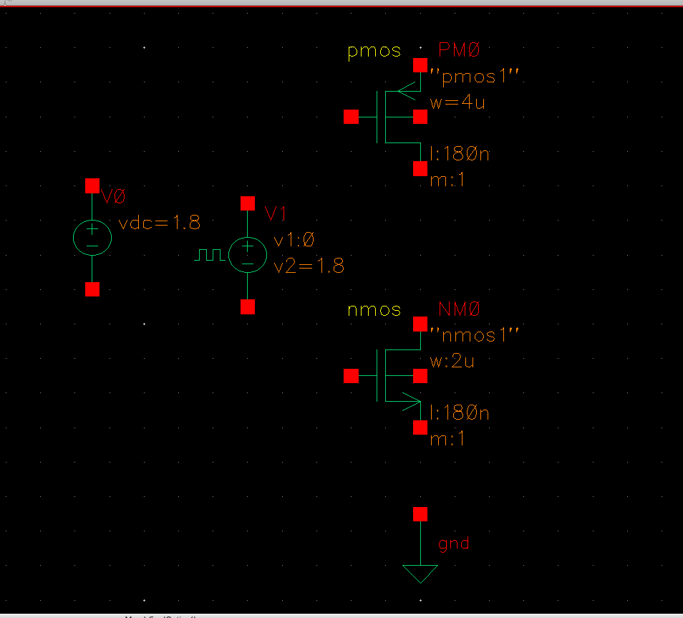

Label the input and output →Create wire name
Once it is done → Check and Save
Go to Launch → ADE L

Slide 28






Choose Different analysis
Setup the output
To run the simulations
Setup → Simulator/DirectoryHost → Spectre

Slide 29


Slide 30


Slide 31

For Voltage Transfer characteristics
Change the source into Vdc
Check and Save→ ADE L

Slide 32





Slide 33




Setup output → Choose Input and output terminals
Variable→ Copy From cellview
Run the simulations

Slide 34


How to create logic symbol
Check and Save
Create→Cellview→From cellview

Slide 35




Change it
Check and Save→ Close it
Check the library Manager

Slide 36


File→ New→Cellview→name it “inv180_test”

Slide 37
VLSI Design Lab
Session No. 02
06/01/2022
Dr. Vijay Rao Kumbhare
Assistant Professor (ECE)
K L University, Hyderabad

Slide 38



CMOS Logic Design
The 2-i/p CMOS NAND Gate:
Two series NMOS and two parallel PMOS
If either input A or B is 0,→ at least one of the NMOS→ OFF
At least on of the pMOS transistor is ON.
Thus, the output Y is pulled up to 1
Conversely, when both the inputs A and B are 1,
Both nMOS→ON,
and Both pMOS→OFF,
and Y is pulled down to ‘0.’
k-input NAND gates are constructed using k series nMOS transistors and k parallel pMOS transistors.

Slide 39








By using combinations of constructions as shown in Fig., CMOS combinational gates can be constructed.
FIGURE 1.15 Connection and behavior of series and parallel transistors

Slide 40


Task-2: The Two-Input NOR Gate
We first consider the CMOS gate that realizes the two-input NOR function

Slide 41


Task-2: The Two-Input NOR Gate
We first consider the CMOS gate that realizes the two-input NOR function

Slide 42


Task-3: The Two-Input NAND Gate
The two-input NAND function is described by the Boolean expression

Slide 43


Task-3: The Two-Input NAND Gate
The two-input NAND function is described by the Boolean expression

Slide 44

2-input XOR gate
INPUT |  | OUTPUT
A | B | A XOR B
0 | 0 | 0
0 | 1 | 1
1 | 0 | 1
1 | 1 | 0

Slide 45

2-input XOR gate

Slide 46




Task-5 Digital logics based on Pass Transistor Logic

Slide 47

AND Gate Pass Transistor Logic

Slide 48

OR Gate Pass Transistor Logic

Slide 49

XNOR Gate Pass Transistor Logic

Slide 50
XNOR Gate Pass Transistor Logic

Slide 51

XOR Gate Pass Transistor Logic

Slide 52


CMOS Transmission gate Logic

Slide 53


CMOS Transmission gate Logic

Slide 54
VLSI Design Lab
Session No. 04
Session Outcome: 1 Design and verify 1-bit comparator
Dr. Vijay Rao Kumbhare
Assistant Professor (ECE)
K L University, Hyderabad
24/01/2022

Slide 55
A Comparator is a combinational circuit that gives output in terms of A>B, A<B, and A=B.
A digital comparator’s purpose is to compare numbers and represent their relationship with each other.

Slide 56

How to design a simple 1-bit comparator?
A 1-bit comparator compares two single bits
For A>B,
there is only one case, when the output is high for A=1 and B=0.
Let’s call this X.
We can write the equation as follows
X(which stands for A>B) = AB’
Similarly, denote A<B with Y.
Since Y is high when A=0 and B=1, we get the following equation
Y = A’B
Similarly, denote A=B with Z.
Since Z is high in two cases, there will be an OR gate.
This is because the logic behind an OR gate is that a high output can be achieved in one or more cases. Z is high when A=0 and B=0, it is also high when A=1 and B=1.
Therefore,
Z = A’B’ + AB

Slide 57

X(which stands for A>B) = AB’
Y = A’B
Z = A’B’ + AB

Slide 58
VLSI Design Lab
Session No. 05 and 06
Session Outcome: 1 Design of 2:1 MUX using Pass Transistor and Transmission Gate Logic
AND
Session Outcome: 1 Design and verify half adder
Dr. Vijay Rao Kumbhare
Assistant Professor (ECE)
K L University, Hyderabad
31/01/2022
07/02/2022

Slide 59
Pass Transistor
In electronics, pass transistor logic (PTL) describes several logic families used in the design of integrated circuits.
It reduces the count of transistors used to make different logic gates, by eliminating redundant transistors.
This reduces the number of active devices, but has the disadvantage that the difference of the voltage between high and low logic levels decreases at each stage.
Each transistor in series is less saturated at its output than at its input.
If several devices are chained in series in a logic path, a conventionally constructed gate may be required to restore the signal voltage to the full value.
Conventional CMOS logic switches transistors so the output connects to one of the power supply rails, so logic voltage levels in a sequential chain do not decrease.

Slide 60
Pass transistor logic often uses
fewer transistors,
runs faster, and
requires less power than the same function implemented with the same transistors in fully complementary CMOS logic.

Slide 61






Pass Transistor
The strength of a signal is measured by how closely it approximates an ideal voltage source.
The power supplies, or rails, (VDD and GND) are the source of the strongest 1s and 0s.
An nMOS transistor is an almost perfect switch, when passing a 0 and thus we say it passes a strong 0. However, the nMOS transistor is imperfect at passing a 1.
nMOS
passes a degraded or weak 1
A pMOS transistor again has the opposite behavior, passing strong 1s but degraded 0s.
pMOS
passes a degraded or weak 0

Slide 62


Slide 63


Slide 64


Slide 65


Slide 66




Transmission Gate
By combining an nMOS and a pMOS transistor in parallel, we obtain a switch that turns on when a 1 is applied to g in which 0s and 1s are both passed in an acceptable fashion.
This a transmission gate or pass gate.
In a circuit where only a 0 or a 1 has to be passed, the appropriate transistor (n or p) can be deleted, reverting to a single nMOS or pMOS device.

Slide 67


Slide 68
Thank you

Slide 69

Weak 1 in nMOS
nMOS transistor with the gate and drain tied to VDD.
Imagine that the source is initially at Vs = 0.
Vgs > Vtn, so the transistor is ON and current flows.
If the voltage on the source rises to Vs =VDD – Vtn, Vgs falls to Vtn and the transistor cuts itself OFF.
Therefore, nMOS transistors attempting to pass a 1 never pull the source above VDD – Vtn.
This loss is sometimes called a threshold drop.
Moreover, when the source of the nMOS transistor rises, Vsb becomes nonzero.
This nonzero source to body potential introduces the body effect that increases the threshold voltage.

